Slide 1
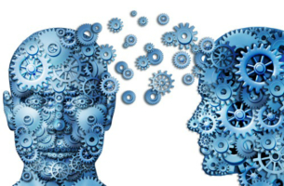
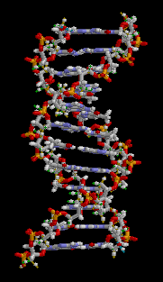
AI and ML for execs - why (and how) your company/department MUST adapt to survive.
SOA Predictive Analytics Symposium – Minneapolis, MN September 21, 2018 - Session 41 9:30 – 10:45 am
Dave Snell, FALU, FLMI, ASA, MAAA, CLU, ChFC, ARA, ACS, MCP
technology evangelist, SnellActuarialConsulting - dave@ActuariesAndTechnology.com
Get the slide images at www.github.com/DaveSnell/PASymp2018-AI-ML

Slide 2
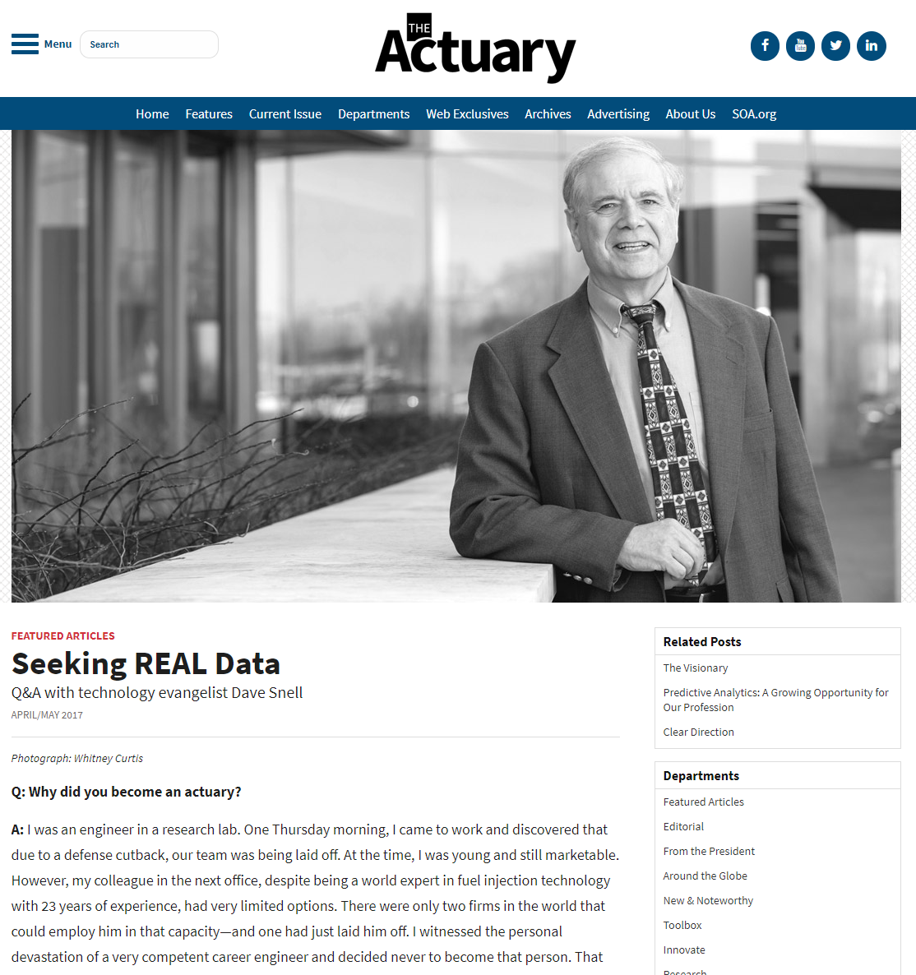
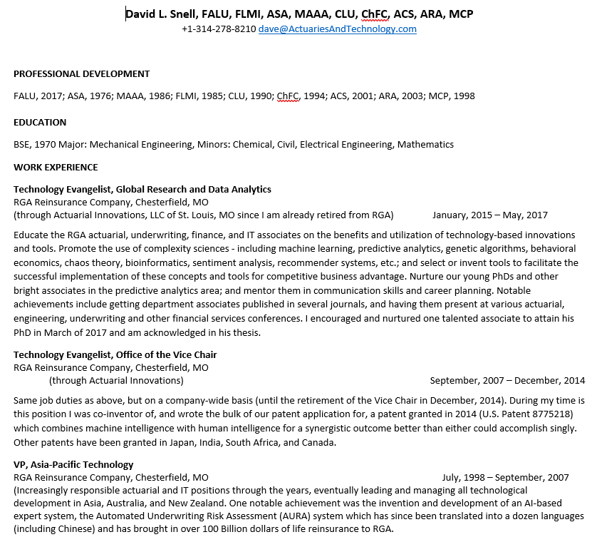
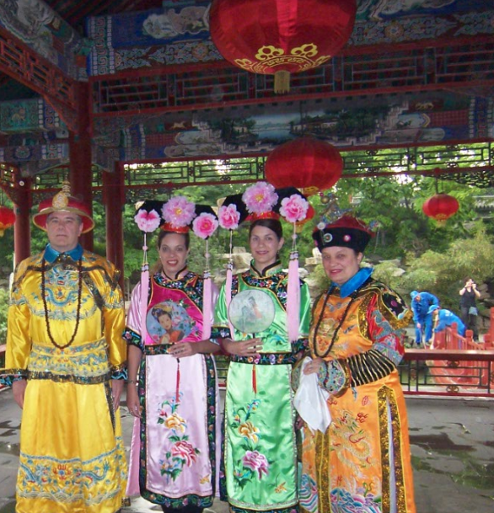
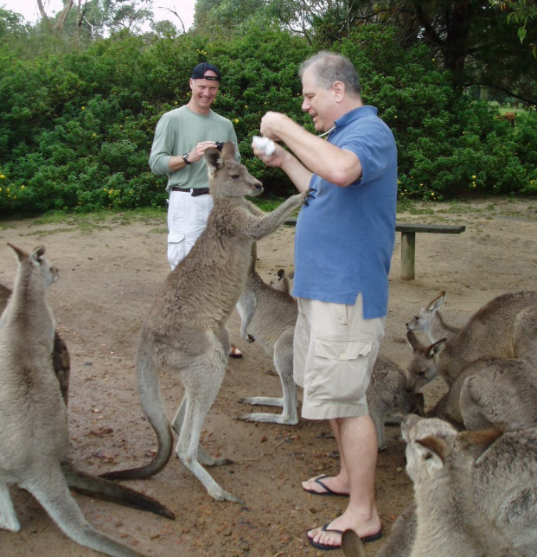
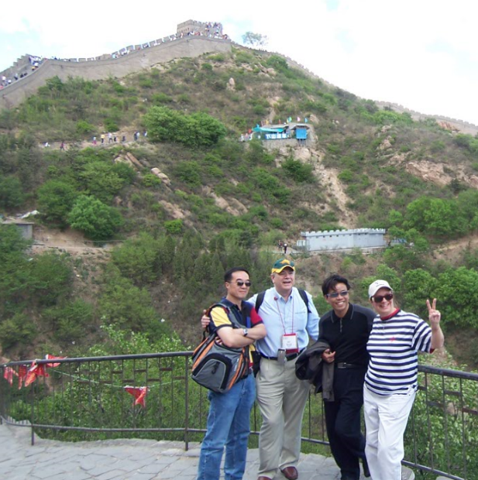
Introductions
Why listen to an OLD guy about NEW stuff?
Business casual in Beijing?
http://www.theactuarymagazine.org/seeking-real-data
RETIRED … and loving teaching AI and ML at Maryville University
Another brick in the wall?
A mob of fans

Slide 3
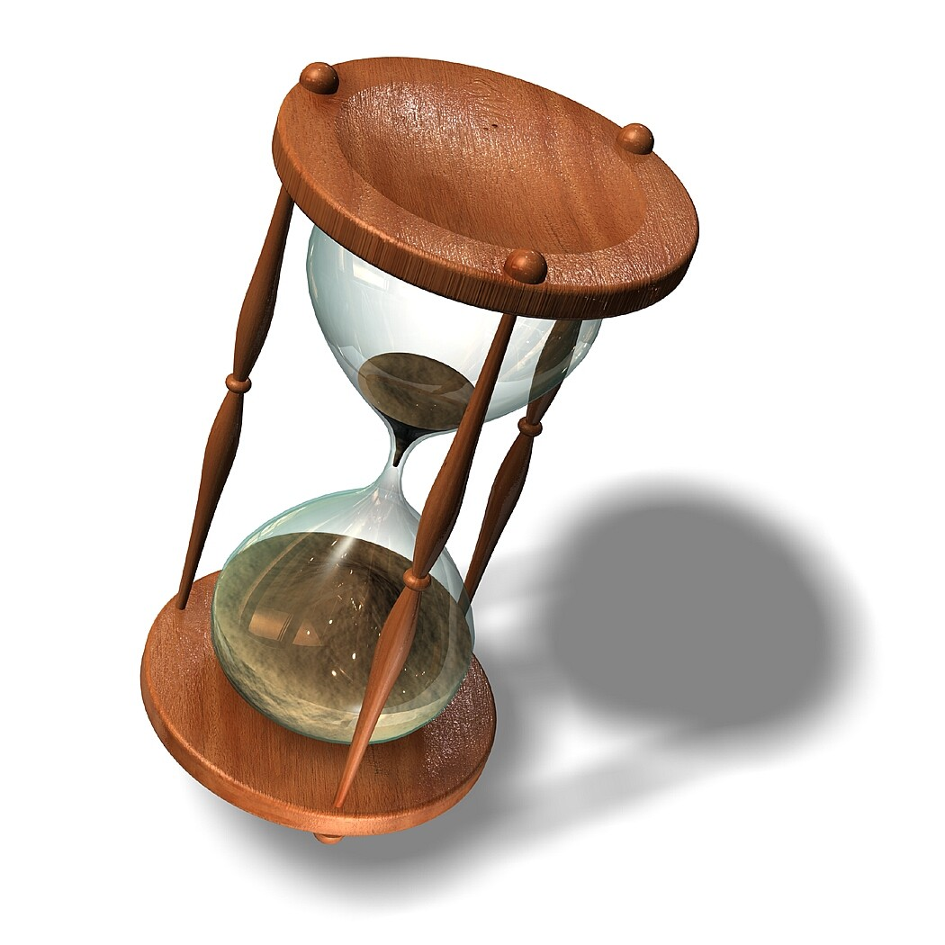
A Few Modest Goals for this first class
How is AI rapidly changing our world?
Why is Machine Learning suddenly feasible decades after the major algorithms were developed?
What implication does this have for insurance?
What are some of the major techniques involved (beyond typical regression and classification)?
decision tree automation and random forests
artificial neural networks, deep learning, and convolutional neural networks
genetic algorithms
A few others we’ll delve into later in the course (besides much going much deeper into these) are:
frequent itemsets, clustering, and other ‘unsupervised’ learning techniques, regression analysis,
Monte Carlo simulations, and behavioral economics, and programming languages for AI and ML.
tiny subset we can summarize today
How does machine learning differ from the classical tools and techniques that actuaries and IT professionals have been using?
What is the ‘magic’ behind these methods?
What are some case studies of successful past applications … and lost opportunities?
Where (and how) can we stay viable in the future?
What questions do you have?
AI and ML for execs - ©21-Sep-2018 Dave Snell - dave@ActuariesAndTechnology.com

Slide 4

Let’s talk about Data!

Slide 5

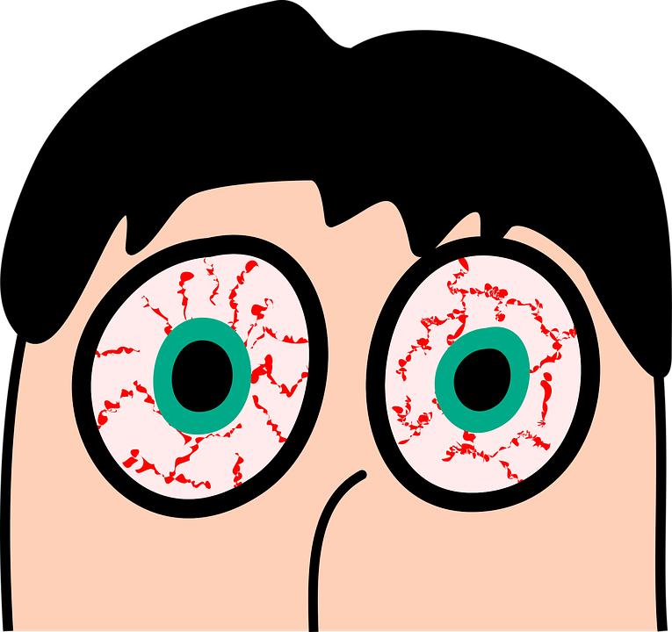
Machine Learning had to wait for ample and affordable data, computing power, and storage
According to an IDC study for EMC, humans have created 132 exabytes of data from the beginning of human civilization to year 2005.
2010: 1,200 exabytes … 2015: 7,900 exabytes … 2020: 40,700 exabytes of data (est.)
Source: Vernon Turner – Senior VP, Enterprise Infrastructure, Consumer, Network, Telecom and Sustainability Research, IDC – April, 2014 https://www.emc.com/leadership/digital-universe/2014iview/digital-universe-of-opportunities-vernon-turner.htm
Perspective:
1 byte – a single character
2 kilobytes – a typewritten page
5 megabytes – the complete works of Shakespeare
1 gigabyte – a pickup truck filled with paper filled with printed words
10 terabytes – the printed collection of the U.S. Library of Congress
2 petabytes – all U.S. academic research libraries
5 exabytes – all words ever spoken by human beings (printed)
http://highscalability.com/blog/2012/9/11/how-big-is-a-petabyte-exabyte-zettabyte-or-a-yottabyte.html
https://www.youtube.com/yt/about/press/ 27-Oct-2017
AI and ML for execs - ©21-Sep-2018 – Dave Snell - dave@ActuariesAndTechnology.com

Slide 6
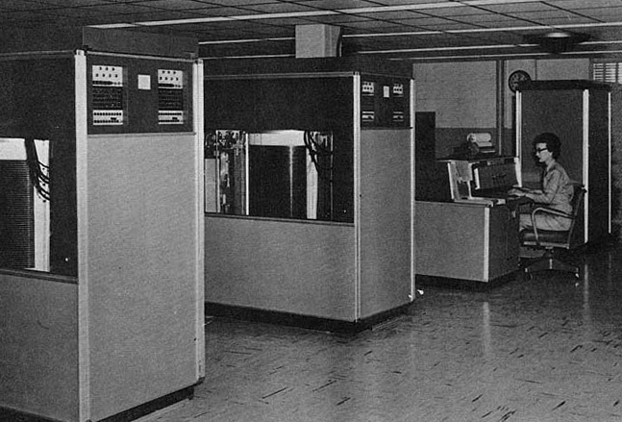
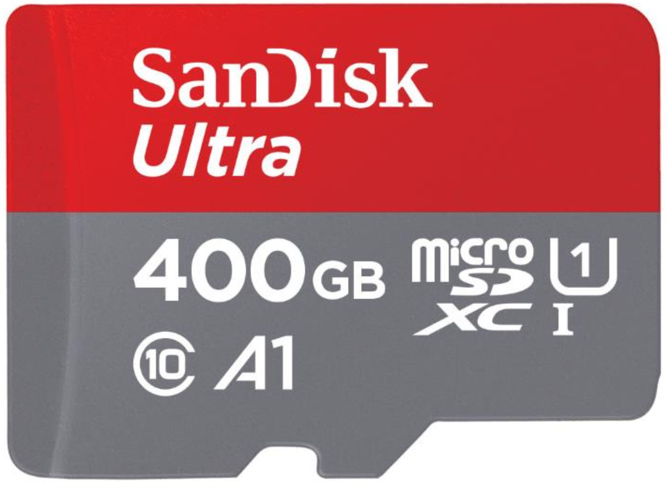
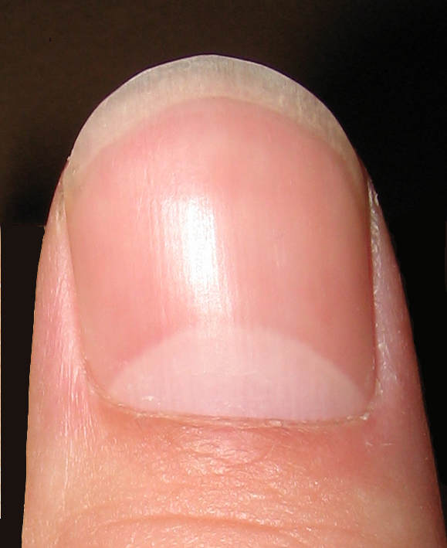
Machine Learning had to wait for ample and affordable data, computing power, and storage
As of 26-June-2018 you can buy more than 100,000 times the storage for under $250 and it will be about as large as your fingernail.
In 1957, the IBM 350 storage drive held 3.5 MB. You could rent it for $3,200 per month. The 350's cabinet is 5 feet long; 5 feet, 8 inches high and 2 feet, 5 inches wide.
Source: Wikipedia 24-Oct-2017 https://en.wikipedia.org/wiki/History_of_IBM_magnetic_disk_drives#IBM_350
AI and ML for execs - ©21-Sep-2018 – Dave Snell - dave@ActuariesAndTechnology.com

Slide 7
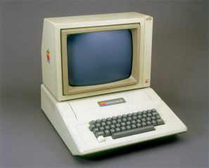
Machine Learning had to wait for ample and affordable data, computing power, and storage
In 1979, I needed an additional 16 K Language Card for my Apple II (in order to program in UCSD Pascal). It cost me more than $300 for the 16 K of additional random access storage. There was no option then for a hard drive.
Today, you can buy a 4 Terabyte hard drive for under $100.
"Today, your cell phone has more computer power than all of NASA back in 1969, when it placed two astronauts on the moon." - Dr. Michio Kaku, 2014 (theoretical physicist, futurist, and popularizer of science; professor of theoretical physics at the City College of New York and CUNY Graduate Center.)
The wait is over!
Cost | KB | Cost/KB | Cost/GB
$300 (1979) | 16 | $18.75 | $18,750,000
$100 (2017) | 4,000,000,000 | $ 0.000000025 | $ 0.025
AI and ML for execs - ©21-Sep-2018 – Dave Snell - dave@ActuariesAndTechnology.com

Slide 8
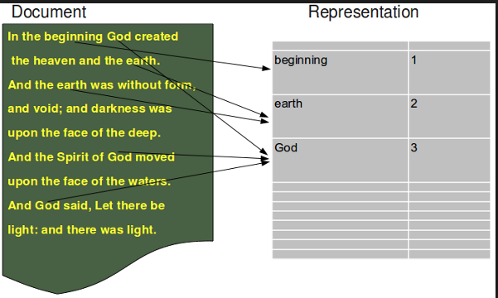
Big Data is all around us – much publicly posted
1% sample of 332,900 tweets in 5 seconds
> proc.time()-ptm
user system elapsed
0.08 0.00 5.02
>
> tweets.df <- parseTweets("tweets_sample.json")
332900 tweets have been parsed.
> tail(tweets.df$text,20)
[1] "RT @yuteesonyu: ไม่เห็นด้วยกับรูปนี้เลย ไม่ใช่คนไทยทุกคนที่คิดแบบนี้ แล้วก็ไม่ใช่ฝรั่งทุกคนที่คิดแบบนี้ คนไทยดีๆก็มี ฝรั่งแย่ๆก็มี https://…"
[2] "Psychedelic Padded Pipe Pouch by https://t.co/GRpeEhB0n3 https://t.co/rDRSdbBN5v via @Etsy #hippy #weed #smoke #can
[3] "RT @teed_chris: WISCONSIN,, TRUMPSTERS, AMERICANS, WE COME TOGETHER FOR A BATTLE TODAY, AND FOR OU
[4] "@tabo_luv_ST 音だけ流れ続けて画面真っ暗～ｗｗｗ"
[5] "@nozomieiei …知ってる"
[6] "So much pain inside him.Immense betray from Yulin humans #StopYuLin4ever https://t.co/EZaxTDJ5q0"
[7] "RT @sylvmic: Check out these awesome @5SOS headphones!! https://t.co/9hkaYaABwM #essential5SOS https://t.co/WfIzaxV
[8] "RT @skywalkgrier: et le 3x01 qd il l'appel pr son anniv alors qu'il a perdu son humanité https://t.co/yNI7qIE0VU"
[9] "猫をあやす棗さんが可愛すぎて歯磨き粉噴出した"
[10] "こんな時間に腹減り"
[11] "RT @tomozh: 大変だった時に使うハンコできた https://t.co/48VaQbVcpx"
[12] "あっ"
[13] "モイ！iPhoneからキャス配信中 - https://t.co/ccrG6sHn43"
[14] "RT @KSeriesAD: พัคโบกอม ถ่ายแบบให้กับแบรนด์ MontBell คอลเลคชั่น S/S 2016 / หล่อ น่ารัก \xed��\xed�\u0095 https://t.co/lKAxtVcGrD"
[15] "RT @SHXBL94_: ไม่ใช่คนที่โลกส่วนตัวสูงครับ ไม่ใช่คนที่เข้ากับคนยาก ตรงกันข้ามผมเข้ากับคนอื่นง่าย แต่ผมแค่เลือกคนที่จะให้รู้เรื่องส่วนตัวของ…"
[16] "RT @ARS_C_bot: 青「パクに土偶と埴輪の違いは解りますか？って聞いてみたら\n緑『解りますよ！土偶はこう(土偶のポーズ)で埴輪はこう(埴輪のポーズ)ですよね！』って答えられた。そういう話じゃない」"
[17] "@kurooshiteru @tohruoikawa don't worry. Even in Japan I wouldn't have done that. What do you take me for?? Some weeb??
[18] "Ladies https://t.co/ELNALcLYyu"
[19] "【定期】すべての人に好かれる気はないし必要ないと思ってる。ごく少数の仲のいい人が出来ればそれでいい。"
[20] "@june7845 고양이귀랑 꼬리랑 발 달고 고양이란제리랑 스타킹 입고 사진찍자"
Tweets captured by author May, 2016
AI and ML for execs - ©21-Sep-2018 – Dave Snell - dave@ActuariesAndTechnology.com

Slide 9
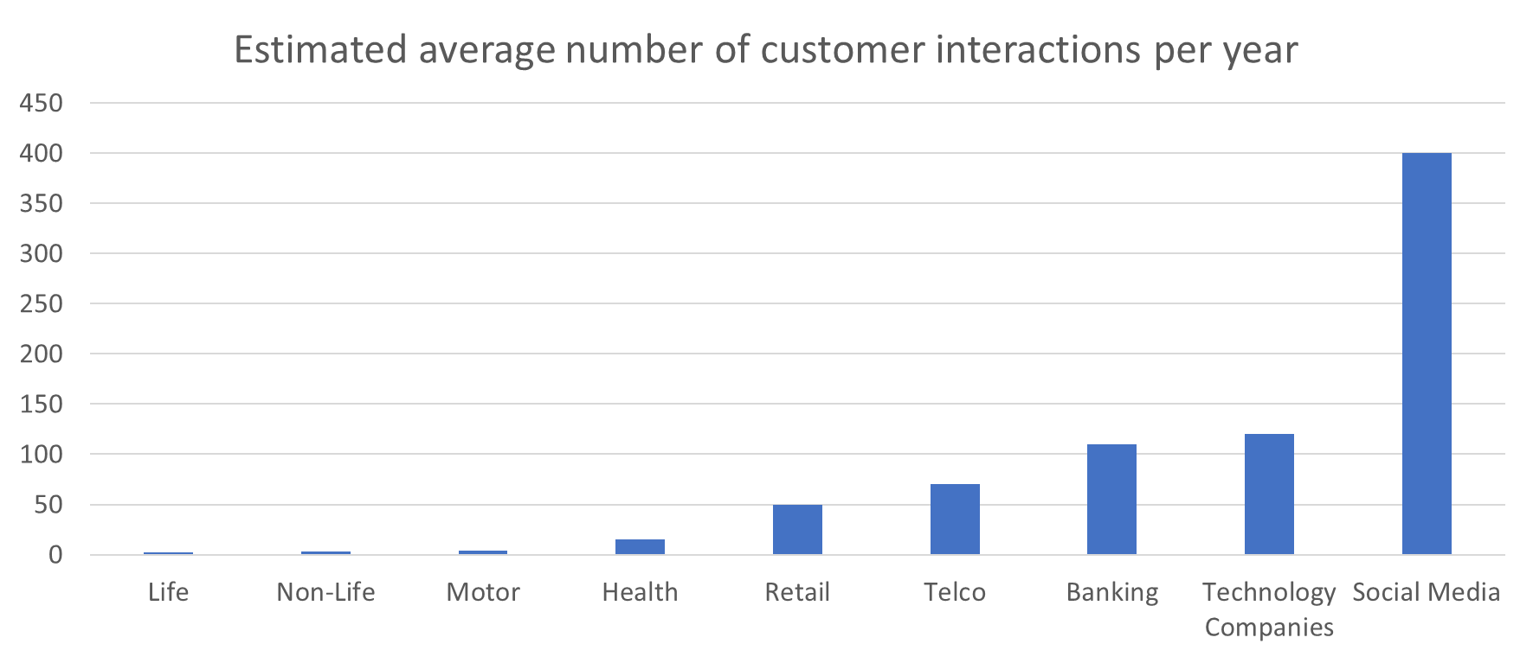
Insurance companies have barely tapped into the amount of data available on our customers
Source: McKinsey & Company, presented in Transforming Life Insurance with Design Thinking
AI and ML for execs - ©21-Sep-2018 – Dave Snell - dave@ActuariesAndTechnology.com

Slide 10
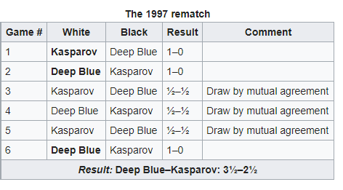
11-May-1997: Deep Blue Beats World Champion Chess Player
Source: Wikipedia as of 24-Oct-2017 https://en.wikipedia.org/wiki/Deep_Blue_versus_Garry_Kasparov
AI and ML for execs - ©21-Sep-2018 – Dave Snell - dave@ActuariesAndTechnology.com

Slide 11
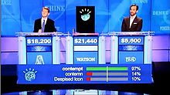
15-Feb-2011: Watson Beats Jeopardy Champions
Ken Jennings, Watson, and Brad Rutter in their Jeopardy! exhibition match.
Source Wikipedia as of 24-Oct-2017
https://en.wikipedia.org/wiki/Watson_%28computer%29
AI and ML for execs - ©21-Sep-2018 – Dave Snell - dave@ActuariesAndTechnology.com

Slide 12
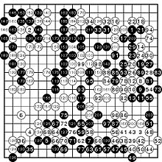
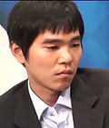
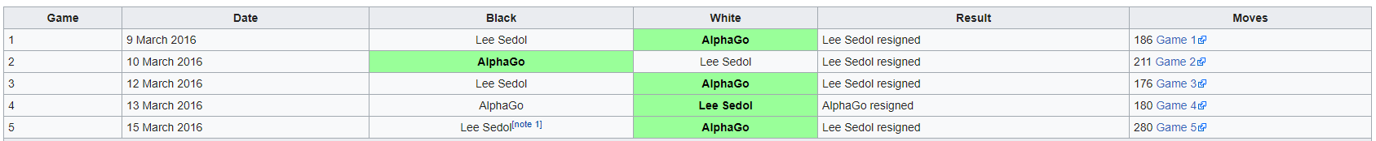
15-Mar-2016: AlphaGo (Google DeepMind) Beats 18-time world champion Lee Sedol in Go
Source: Wikipedia 24-Oct-2017 https://en.wikipedia.org/wiki/AlphaGo_versus_Lee_Sedol
AI and ML for execs - ©21-Sep-2018 – Dave Snell - dave@ActuariesAndTechnology.com

Slide 13
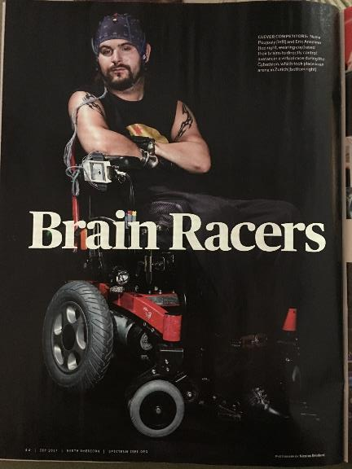
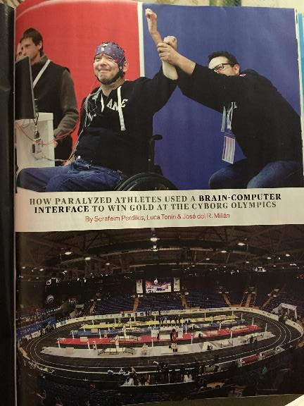
Sep-2017: AI helmets interpret brain waves and enable even quadriplegics to race in cyborg Olympics
IEEE Spectrum
September, 2017
AI and ML for execs - ©21-Sep-2018 – Dave Snell - dave@ActuariesAndTechnology.com

Slide 14

11-Sep-2017: Machine Learning was used at Georgia Institute of Technology to recreate game code (old Atari video games) by watching the game being played.
https://m.techxplore.com/news/2017-09-artificial-intelligenceuses-minutes-videogame-footage.html
AI and ML for execs - ©21-Sep-2018 – Dave Snell - dave@ActuariesAndTechnology.com

Slide 15
18-Oct-2017: Google Deep Mind’s AlphaGo Zero Beats AlphaGo 100 games to zero
https://urldefense.proofpoint.com/v2/url?u=http-3A__www.bbc.com_news_technology-2D41668701&d=DwICAg&c=5uPv0lijNz76uSeaN5P0Zw&r=nkBVelrgsdY8RB9we12wjuanvgjtPHK9USWccjOv9NM&m=f_U2WRfiIOtw80O0kElpti1V9SR09KBHyTbVAujaXQ&s=mBZ7O9o9Szof_oRjuxxyPKvi8K5dK4BzzZx3Totkglo&e=
The AlphaGo program, devised by the tech giant's AI division, has already beaten two of the world's best players. It had started by learning from thousands of games played by humans.
But the new AlphaGo Zero began with a blank Go board and no data apart from the rules, and then played itself. Within 72 hours it was good enough to beat the original program by 100 games to zero.
AI rocks!
Machine Learning is amazing!
AI and ML for execs - ©21-Sep-2018 – Dave Snell - dave@ActuariesAndTechnology.com

Slide 16
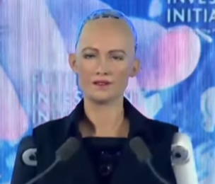
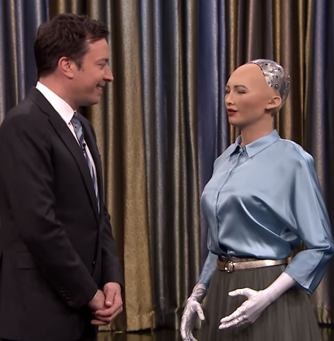
26-Oct-2017 Sophia, an intelligent humanoid robot, has been granted citizenship in Saudi Arabia.
“I am very honored and proud for this unique distinction,” the robot said onstage. “This is historical to be the first robot in the world to be recognized with a citizenship.”
CNBC's Andrew Ross Sorkin interviews Sophia, a humanoid robot, about the future of artificial intelligence at a Future Investment Institute panel in Saudi Arabia. Link to YouTube interview with Sophia: https://www.youtube.com/watch?v=S5t6K9iwcdw
You may also enjoy her interview with Jimmy Fallon from 25-Apr-2017: https://www.youtube.com/watch?v=Bg_tJvCA8zw
Watch from 2:08 to 5:29 minutes
AI and ML for execs - ©21-Sep-2018 – Dave Snell - dave@ActuariesAndTechnology.com

Slide 17
20-Nov-2017 Robot Passes Medical Exam
https://futurism.com/first-time-robot-passed-medical-licensing-exam/
by Dom Galeon November 20, 2017 Artificial Intelligence
IN BRIEF
Chinese AI-powered robot Xiaoyi took the country's medical licensing examinations and passed, according to local reports. Xiaoyi is just one example of how much China is keen on using AI to make a number of industries more efficient.
A ROBOT MEDICAL PROFESSIONAL
Experts generally agree that, before we might consider artificial intelligence (AI) to be truly intelligent —that is, on a level on par with human cognition— AI agents have to pass a number of tests. And while this is still a work in progress, AIs have been busy passing other kinds of tests.
Xiaoyi, an AI-powered robot in China, for example, has recently taken the national medical licensing examination and passed, making it the first robot to have done so. Not only did the robot pass the exam, it actually got a score of 456 points, which is 96 points above the required marks.
AI and ML for execs - ©21-Sep-2018 – Dave Snell - dave@ActuariesAndTechnology.com

Slide 18
7-Dec-2017 In Just 4 Hours, Google’s AI Mastered All The Chess Knowledge in History
“After being programmed with only the rules of chess (no strategies), in just four hours AlphaZero had mastered the game to the extent it was able to best the highest-rated chess-playing program Stockfish.”
“In a series of 100 games against Stockfish, AlphaZero won 25 games while playing as white (with first mover advantage), and picked up three games playing as black. The rest of the contests were draws, with Stockfish recording no wins and AlphaZero no losses.”
Source: https://futurism.com/4-hours-googles-ai-mastered-chess-knowledge-history/
AI and ML for execs - ©21-Sep-2018 – Dave Snell - dave@ActuariesAndTechnology.com

Slide 19
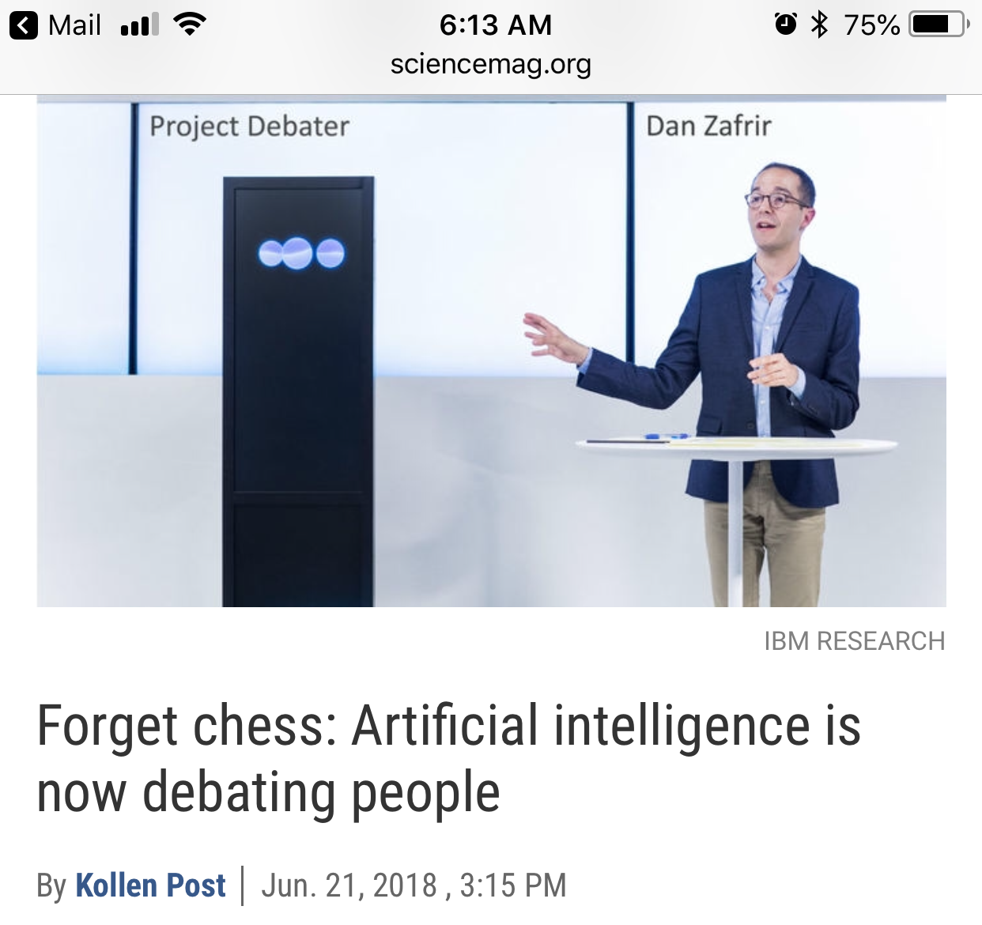
18-Jun-2018 IBM computer debates humans and wins on one of two topics
I just watched an IBM computer debate a human. Two debates; the computer won one of them. Of course it was the debate on the use of telemedicine. The human was making the case for our species and human doctors. The computer made the case for the technology. – Laura Sydell (NPR)
7:06 PM - 18 Jun 2018 from San Francisco, CA
There was kind of a funny moment where the human debaters said that they didn't think that telemedicine was good - this is when doctors treat people from a distance - because you didn't have the physical hand of the doctor or the nurse, and the computer responded with some humor. “It said, I am a true believer in the power of technology, as I should be.” - Project Debater, by IBM
AI and ML for execs - ©21-Sep-2018 – Dave Snell - dave@ActuariesAndTechnology.com

Slide 20
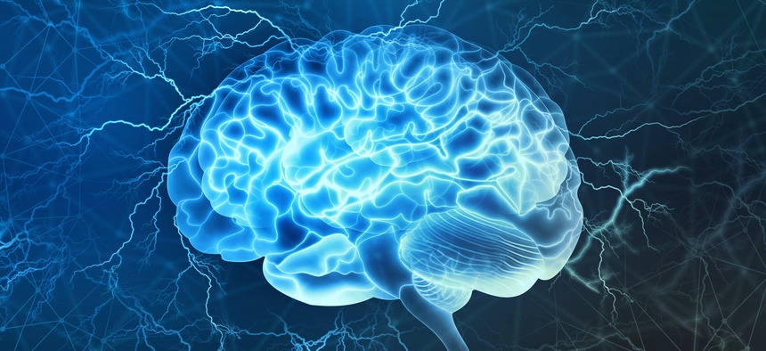
17-Jul-2018 The Pentagon Wants to Bring Mind-Controlled Tech To Troops
https://www.nextgov.com/emerging-tech/2018/07/pentagon-wants-bring-mind-controlled-tech-troops/149776/
JULY 17, 2018
The Defense Department’s research arm is working on a project that connects human operators’ brains to the systems they’re controlling—and vice versa.
The idea of humans controlling machines with their minds has spun off sci-fi blockbusters like “Pacific Rim” and entire subgenres of foreign film, but while today skyscraper-sized fighting robots exist only on the big screen, the Pentagon is building technology that could one day make them a reality.
Today, the Defense Advanced Research Projects Agency is selecting teams to develop a “neural interface” that would both allow troops to connect to military systems using their brainwaves and let those systems transmit back information directly to users’ brains.
AI and ML for execs - ©21-Sep-2018 – Dave Snell - dave@ActuariesAndTechnology.com

Slide 21
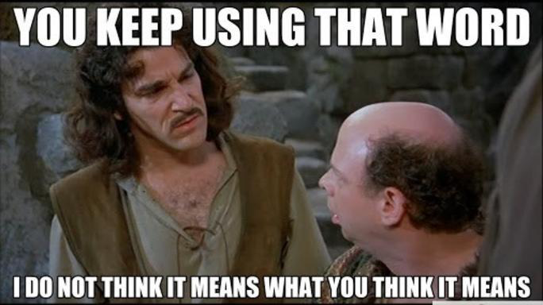
But What is AI?
But What is Machine Learning?
slide idea from Jim Guszcza, US chief data scientist, Deloitte Consulting

Slide 22
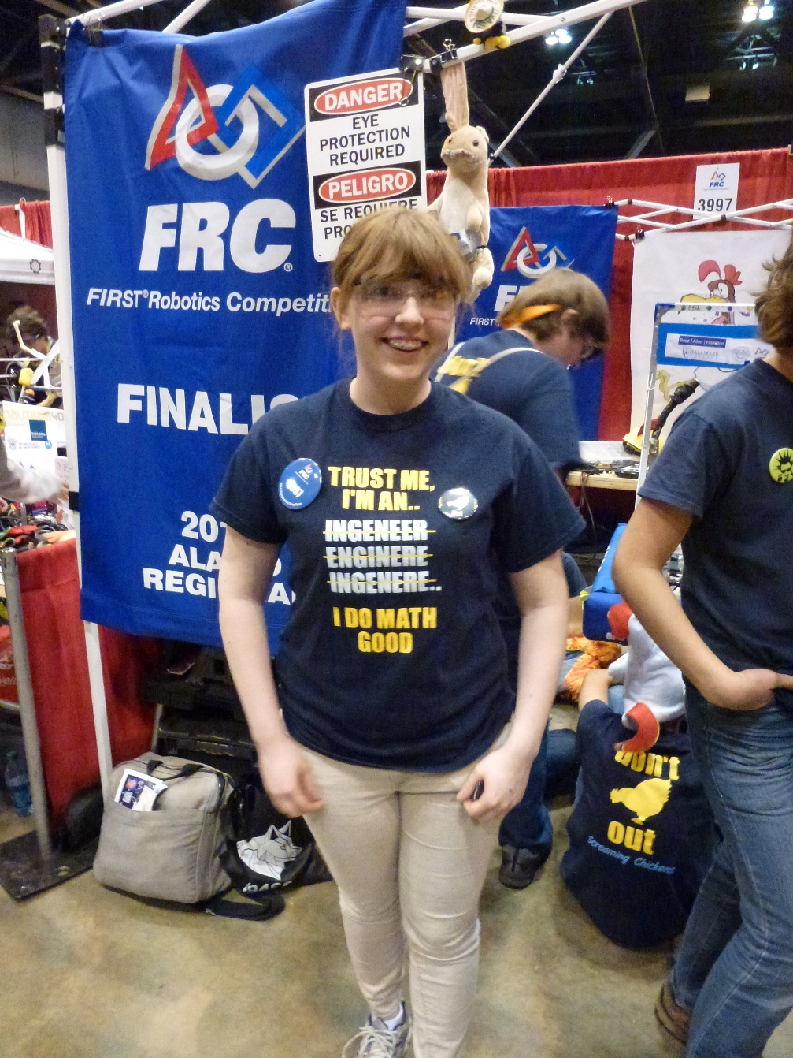
What is Artificial Intelligence? What is Machine Learning?
They are not magic!
“Any sufficiently advanced technology is indistinguishable from magic.”
– Sir Arthur C. Clarke
Forbes: 20-Jan-2016
Data Scientist tops list of best jobs in United States
Original picture by author at FIRST Robotics Competition, St. Louis, MO – April 2014
AI and ML for execs - ©21-Sep-2018 – Dave Snell - dave@ActuariesAndTechnology.com

Slide 23
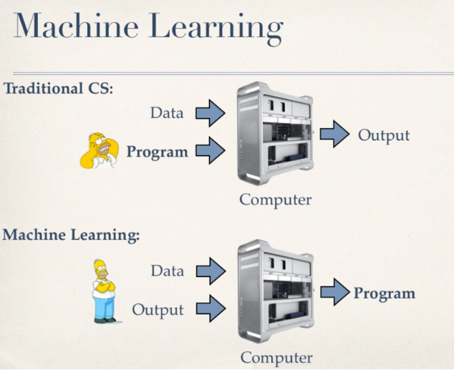
Overview of Machine Learning
Machine Learning
Source: Machine Learning in practice – common pitfalls, and debugging tricks, by Kilian Weinberger, Associate Professor, University of Washington
AI and ML for execs - ©21-Sep-2018 – Dave Snell - dave@ActuariesAndTechnology.com

Slide 24
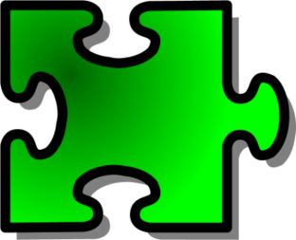
Traditional rule trees lack flexibility
Rule 8
Rule 16
Rule 3
Rule 20
Rule 20
Rule 2
Rule 9
Rule 17
Rule 20
Rule 20
Rule 4
Rule 20
Rule 10
Rule 18
Rule 20
Rule 20
Rule 1
New data
Rule 20
Rule 11
Rule 19
Rule 20
Rule 5
Rule 20
Rule 20
Rule 20
Rule 12
Rule 20
Rule 20
Rule 21
Rule 6
Rule 200
Rule 13
Rule 7
Rule 14
… and important new data (perhaps from entirely new sources) just does not fit in!
A missing data point can invalidate a whole branch of rules logic
Rule 15
Images by Dave Snell
AI and ML for execs - ©21-Sep-2018 – Dave Snell - dave@ActuariesAndTechnology.com

Slide 25
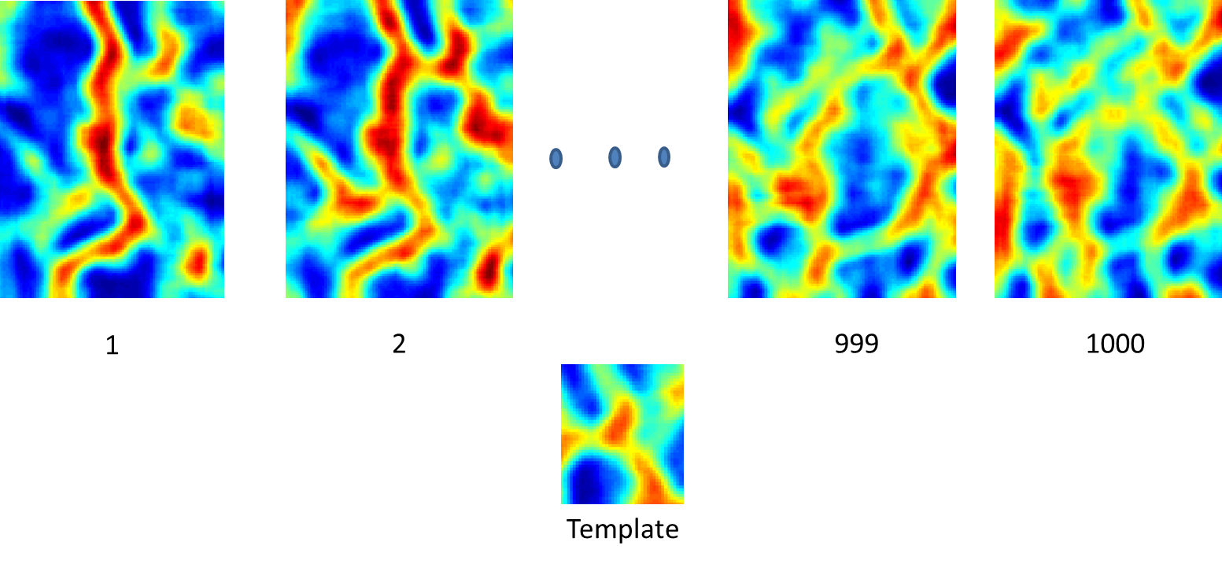
Pattern Matching is more flexible
Each scored case becomes a potential match
The fit may be perfect, or approximate, with a measure of closeness
Case input pattern
images by Dave Snell
AI and ML for execs - ©21-Sep-2018 – Dave Snell - dave@ActuariesAndTechnology.com

Slide 26
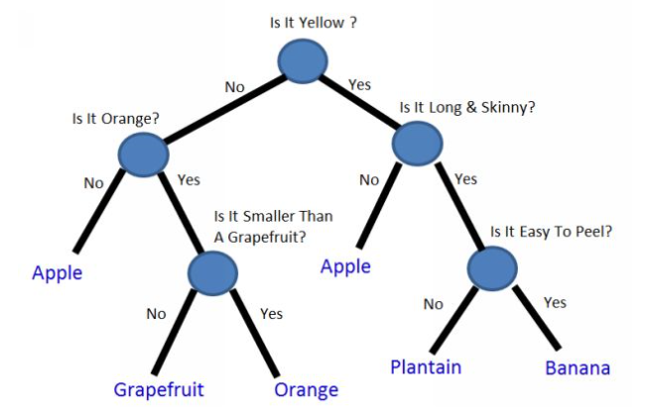
Decision tree example from Machine Learning with Random Forests and Decision Trees by Scott Hartshorn
(available on Amazon for $2.99)
Simple decision tree to classify whether a fruit is an Apple, Grapefruit, Orange, Plantain, or Banana
Note: this example assumes those are the only possibilities. Thus, a lime would be classified as an Apple.
AI and ML for execs - ©21-Sep-2018 – Dave Snell - dave@ActuariesAndTechnology.com

Slide 27
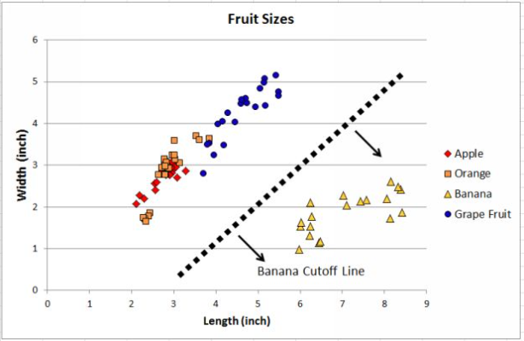
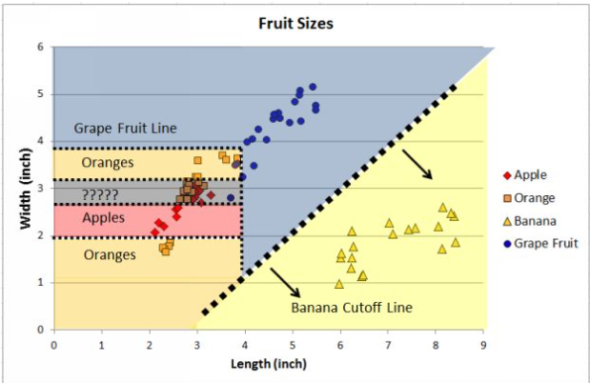
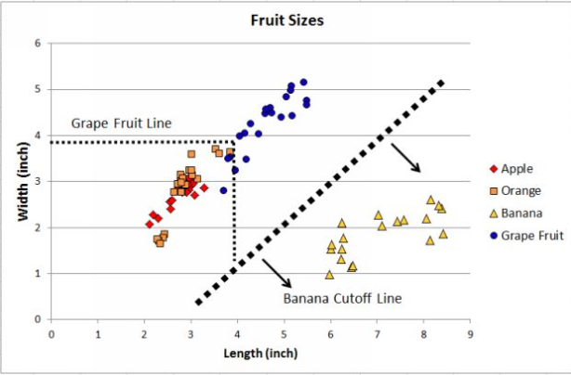
This is how a human might create a set of rules to segregate and identify the four types of fruit.
Quantitatively, the splits are placed where the Gini impurity (or other measure of fit) is minimized.
Decision tree example from Machine Learning with Random Forests and Decision Trees by Scott Hartshorn
AI and ML for execs - ©21-Sep-2018 – Dave Snell - dave@ActuariesAndTechnology.com

Slide 28
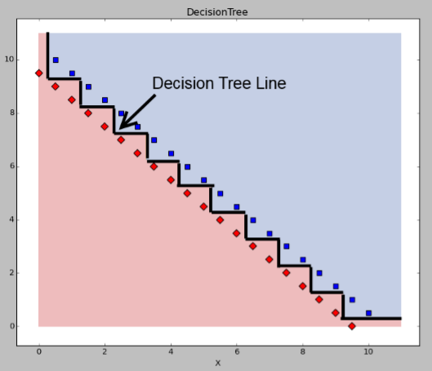
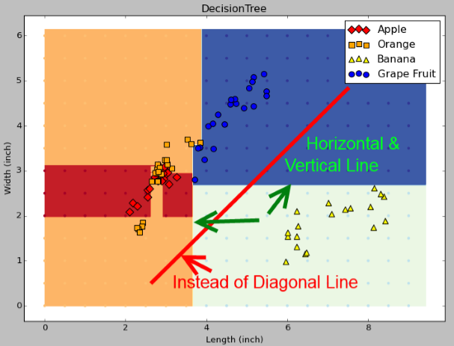
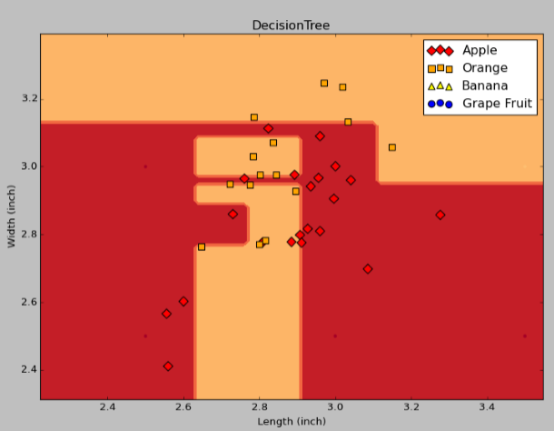
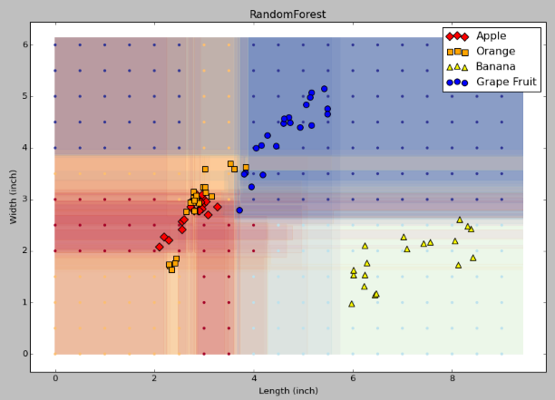
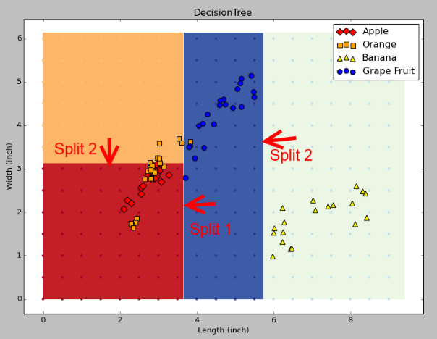
In its attempt to classify ALL of the training data, an individual tree will be prone to overfitting. It is difficult to distinguish between true data, and noise.
Unable to split diagonally, the decision tree algorithm must simulate the split with several vertical and horizontal splits.
A random forest is a collection of many trees, where each tree has been given only a subset of the data and the parameters. The impact of noise is greatly attenuated.
Decision tree example from Machine Learning with Random Forests and Decision Trees by Scott Hartshorn

Slide 29

How Many Trees Should You Have In Your Forest?
Advice from Machine Learning With Random Forests And Decision Trees: A Visual Guide For Beginners, by Scott Hartshorn
More trees are usually better because they will do more to smooth out abnormalities in the data. But that is true only up to a point. This is an area of diminishing returns, where each additional tree will have
less benefit than the one before it. Eventually the benefit will plateau, and more trees will not help very much.
The decision on how many trees to have in the Random Forest becomes a tradeoff dependent on your problem and your computing resources. Going from 10 trees to 50 trees might improve your results significantly, and not add very much time. Going from 1,000 trees to 50,000 trees might add substantial time without improving your results very much.
Using 100 trees in the Random Forest is often a good place to start. Increase later (after tuning other parameters)
AI and ML for execs - ©21-Sep-2018 – Dave Snell - dave@ActuariesAndTechnology.com

Slide 30
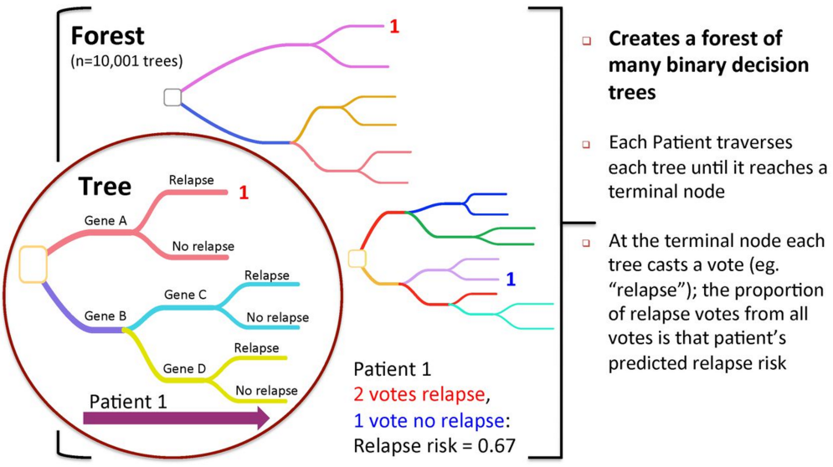
Overview of Random Forests
Images from Wikipedia and designated in public domain
AI and ML for execs - ©21-Sep-2018 – Dave Snell - dave@ActuariesAndTechnology.com

Slide 31
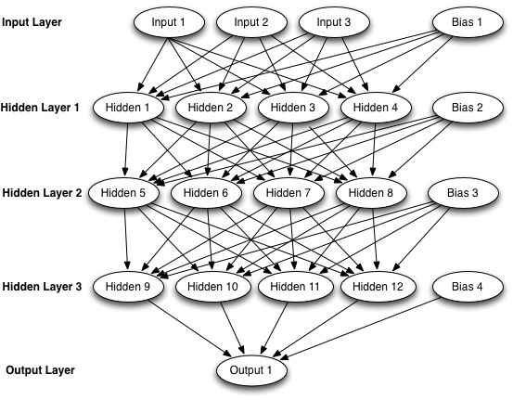
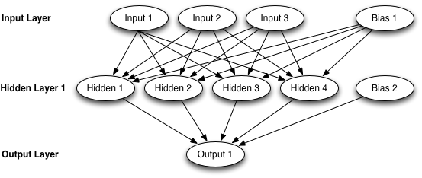
Artificial Neural Networks
Images used with permission from: Heaton, J. (2015). Artificial Intelligence for Humans, Volume 3: Deep Learning and Neural Networks. St. Louis, MO: Heaton Research, Inc, 1505714346.
AI and ML for execs - ©21-Sep-2018 – Dave Snell - dave@ActuariesAndTechnology.com

Slide 32
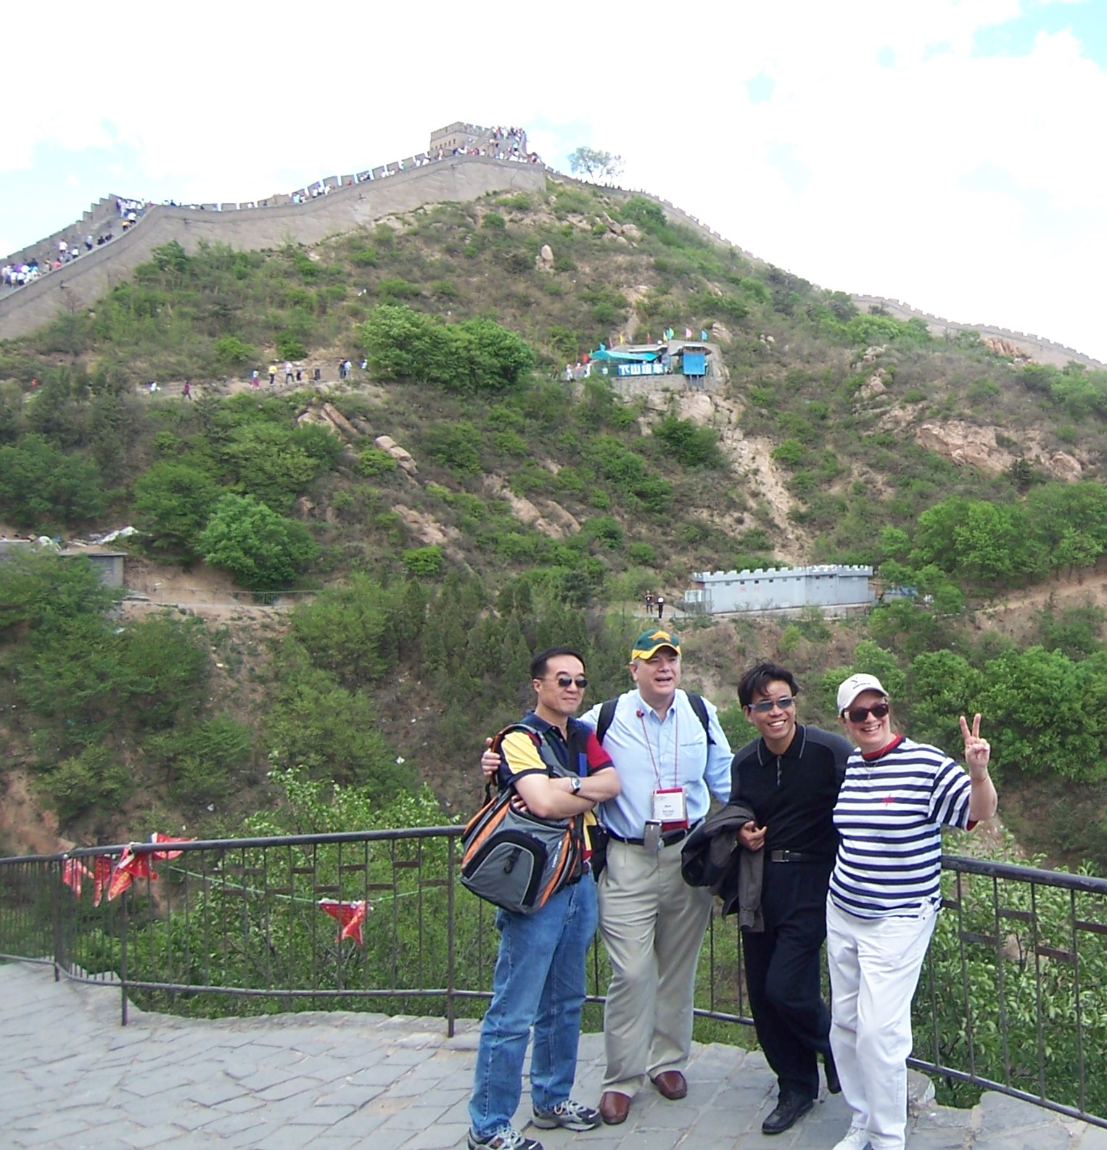
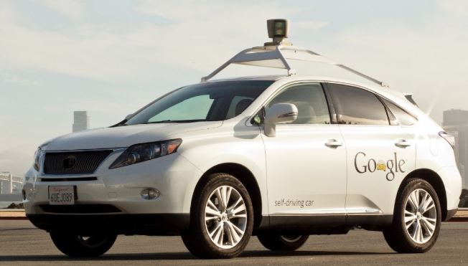
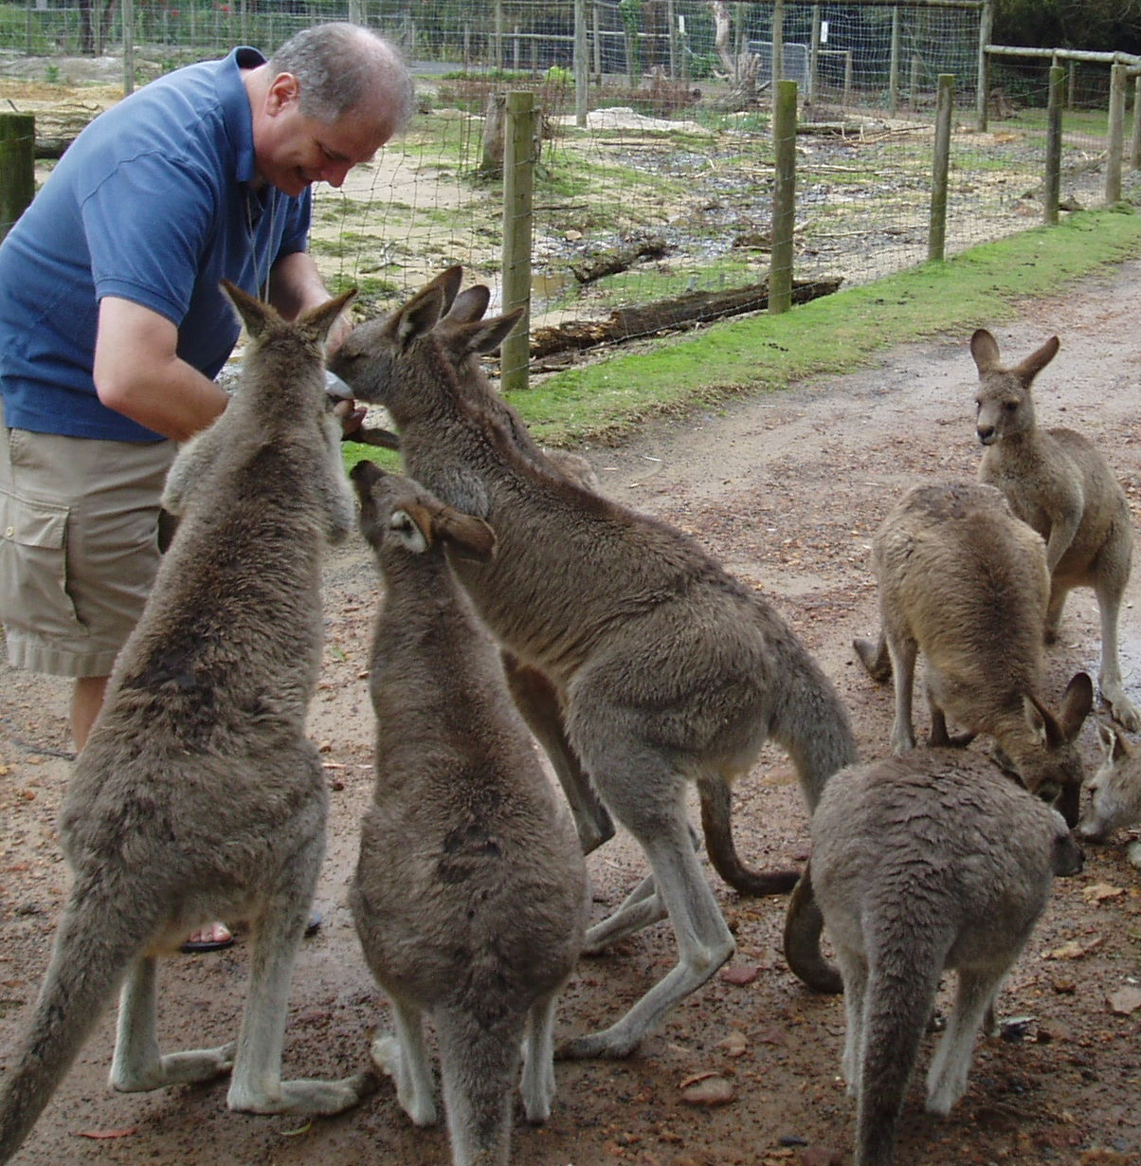
Very good, but still not perfect
Convolutional Neural Networks provide the front end (for Deep Neural Networks) to enable facial recognition and autonomous vehicles.
AI and ML for execs - ©21-Sep-2018 – Dave Snell - dave@ActuariesAndTechnology.com

Slide 33
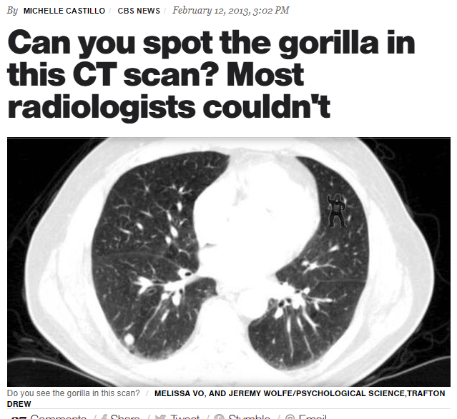
AI and ML for execs - ©21-Sep-2018 – Dave Snell - dave@ActuariesAndTechnology.com

Slide 34
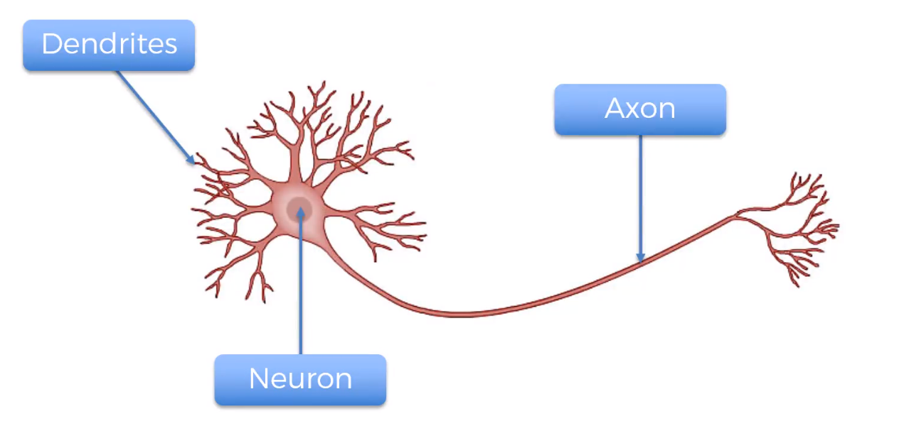
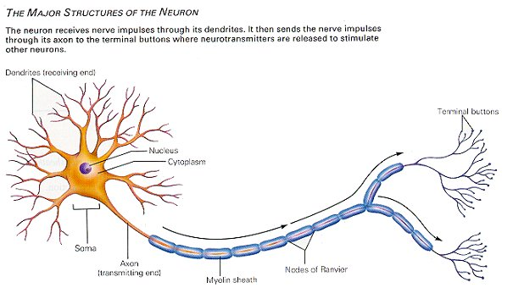
AI and ML for execs - ©21-Sep-2018 – Dave Snell - dave@ActuariesAndTechnology.com

Slide 35
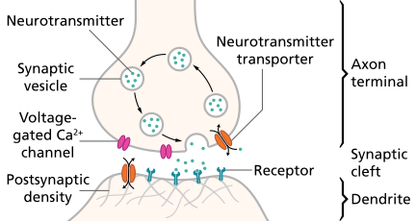
AI and ML for execs - ©21-Sep-2018 – Dave Snell - dave@ActuariesAndTechnology.com

Slide 36



AI and ML for execs - ©21-Sep-2018 – Dave Snell - dave@ActuariesAndTechnology.com

Slide 37




AI and ML for execs - ©21-Sep-2018 – Dave Snell - dave@ActuariesAndTechnology.com

Slide 38

weights
weights
NEURONS
NEURONS
NEURONS
weights
NEURONS
Ŷ_{m} (output values)
Y_{m} = actual values
>>>>>>>>>>forward propagation>>>>>>>>>>>>>>>>>>
Cost Function, C = ½ Sum[(Y – Ŷ)²]
<<<<<back propagation<<<<<<<<<<<<<<<<<<<
Randomly initialize weights to small numbers (but not zero)
Forward propagate vector of first observation to get predicted result Ŷ. Each feature goes into one node of input layer.
Compute and minimize cost function, then update weights according to how much they are responsible for errors (and multiplying by the learning rate). This is called back propagation.
Continue to update weights after each observation (reinforcement learning) or after a batch of observations (batch learning)
An epoch occurs when all of the training set has passed through the process. Redo for as many epochs as desired.
AI and ML for execs - ©21-Sep-2018 – Dave Snell - dave@ActuariesAndTechnology.com

Slide 39

Overview of Predictive Analytics Techniques
Deep Learning
Image used with permission from DataRobot®: https://www.datarobot.com/blog/a-primer-on-deep-learning/
AI and ML for execs - ©21-Sep-2018 – Dave Snell - dave@ActuariesAndTechnology.com

Slide 40


Simple Gradient Descent is great when you have a convex cost function; but what if you have a situation with several local minima? That’s when Stochastic Gradient Descent is used to test several bands within the range of the cost function, and get to better solutions without the need for thousands (or millions … or trillions) of trial and error values.
A free book to explain Deep Learning in more detail:
http://neuralnetworksanddeeplearning.com/
An interactive tool to help you understand the neural network process:
http://www.heatonresearch.com/aifh/vol3/xor_online.html
You are training a neural network for an XOR operator. You can see literally every value that is calculated in the neural network to get each weight.
Jeffrey Heaton FLMI, ARA
Lead Data Scientist
Cost
f(W)
local minimum
global minimum
A gentle introduction to Deep Learning is Jeff’s book:
Weight Vector, W
A best seller on Amazon
AI and ML for execs - ©21-Sep-2018 – Dave Snell - dave@ActuariesAndTechnology.com

Slide 41



No current programming language is ideal for data science (DS), and as DS increases in popularity, there will be replacements that differ considerably from R and Python.
Source for charts: Kdnuggets 30-Aug-2017 https://www.kdnuggets.com/2017/08/python-overtakes-r-leader-analytics-data-science.html
The following Python add-ins are excellent tools to help you take advantage of multiple processors and graphical processing units (GPUs). Install them from an Anaconda prompt as follows:
pip install theano
pip install tensorflow
pip install keras
conda update --all
AI and ML for execs - ©21-Sep-2018 – Dave Snell - dave@ActuariesAndTechnology.com

Slide 42

Why do we call these Genetic Algorithms?
Genetic Algorithms
They mimic our current knowledge of genetics.
We have trillions of cells.
DNA represents a blueprint for a cell.
It is used to generate copies.
The actual process involves proteins and lots of other biological terms …
and you don’t have to know them to solve problems!
AI and ML for execs - ©21-Sep-2018 – Dave Snell - dave@ActuariesAndTechnology.com

Slide 43
Criteria that make a problem suitable for a genetic algorithm
The problem involves a lot of variables - to some extent, the more variables there are, the better this technique applies.
Each variable can take on potential values to produce different solutions.
We can substitute a value for each of the variables and that particular combination of individual values can be thought of as a solution set.
The problem can be quantified in some manner so that any two solution sets can easily be compared to see which is better.
Mitosis/meiosis
Single nucleotide polymorphisms
Alleles/ phenotypes
Adenine, Cytosine, Thymine, Guanine
OMG
That is so simple!
AI and ML for execs - ©21-Sep-2018 – Dave Snell - dave@ActuariesAndTechnology.com

Slide 44
Case study: Health Insurance
A genetic algorithm running on a $300 netbook computer saved millions of dollars on a health provider network setup.
500 provider groups, offering 1 to 25 specialties (acupuncture to x-rays)
If all 500 provider groups were in network, normalized cost would be 1.000
Each group IN or OUT of network
Potential number of solution sets was 2⁵⁰⁰ (a VERY big number)
Best arrangement by experienced actuaries was cost reduction to 0.78
Netbook got to 0.75 within an hour
After three days it reached 0.58
AI and ML for execs - ©21-Sep-2018 – Dave Snell - dave@ActuariesAndTechnology.com

Slide 45

Provider Network Cost Optimization
Each provider group is in (1) or out (0) of network.
Each provider group can have multiple specialists; and has a relative cost.
500 Providers for this example; but could have thousands. Lots of specialties. Could have 2^500 (> 10^150) solution sets … might take a while by traditional methods. ☺
AI and ML for execs - ©21-Sep-2018 – Dave Snell - dave@ActuariesAndTechnology.com

Slide 46

Provider Network Cost Optimization (continued)
Each specialty area must have adequate coverage.
AI and ML for execs - ©21-Sep-2018 – Dave Snell - dave@ActuariesAndTechnology.com

Slide 47
Some problems just don’t fit well into classical methods of solution:
Assume you have three equations:
y₁ = a * e * g + h + dª
y₂ = |h|! - |d|!
y₃ = ((sin(a)) + b) * log(b + c)) + cos(min(c, d)) * (e – f + g * h)
Find a combination of a, b, c, d, e, f, g, h
such that the standard deviation
^{of y}₁^{, y}₂^{, and y}₃ ^{is minimized.}
Oh yeah!
We are math folks, so this might be too easy by itself!
a has to be an integer from 1 to 10
b is a real number from 0 to 15
c is a real number from 1 to 3
d is a real number from 0.5 to 7
e is a real number from -10 to 50
f is an even integer from -20 to 40
g is a real number from 0 to 18
h is a real number from 3 to 12
Let’s add some constraints to make it more interesting!
Click for Live Demo
AI and ML for execs - ©21-Sep-2018 – Dave Snell - dave@ActuariesAndTechnology.com

Slide 48

How to build a genetic algorithm
AI and ML for execs - ©21-Sep-2018 – Dave Snell - dave@ActuariesAndTechnology.com

Slide 49
from elsewhere: elites = 20
setsPerGeneration = 100
parentPool = 40
solutionSets is a
2-dimensional array 30 by100
VBA example code
1 2 3 4 5 6 7 | Private Sub AddTheChildren() Dim parent As Integer, var As Long, child As Integer, children As Integer children = setsPerGeneration - elites For child = 1 To children For var = 1 To setLength parent = Int(parentPool * Rnd()) + 1 solutionSets(var, elites + child) = solutionSets(var, parent) Next var Next child End Sub 'AddTheChildren
(80 = 100 – 20)
(start with child set 1)
(1 to 30 if 30 variables per set)
(e.g. parent 5 wins for variable 17 for child 1)
(so set variable 17 in new solution set 21 = 20 +1 to the value from variable 17 in old solution set 5 )
AI and ML for execs - ©21-Sep-2018 – Dave Snell - dave@ActuariesAndTechnology.com

Slide 50

Input Screen for FREE workbook
Specify the sheet and range for your constraint criteria.
Specify the range for your variable values
Enter the location of the final score
No biology needed!
No programming needed!
AI and ML for execs - ©21-Sep-2018 – Dave Snell - dave@ActuariesAndTechnology.com

Slide 51


Overview of Predictive Analytics Techniques
Frequent Itemsets
Checking Rx history to infer ‘other’ drugs taken by applicant
Image from paper by authors
Utilizing Frequent Itemsets to Model Highly Sparse Underwriting Data – Society of Actuaries - Predictive Analytics 2014 Call For Articles
AI and ML for execs - ©21-Sep-2018 – Dave Snell - dave@ActuariesAndTechnology.com

Slide 52


Overview of Predictive Analytics Techniques
K-Means Clusters Multi-variate Regression
Images from Wikipedia and designated in public domain
AI and ML for execs - ©21-Sep-2018 – Dave Snell - dave@ActuariesAndTechnology.com

Slide 53


For the first time in history, more people die today
from eating too much than from eating too little;
more people die from old age than from infectious diseases;
more people commit suicide than are killed by soldiers, terrorists and criminals combined.
A few serious scholars suggest that by 2050, some humans will become a-mortal (not immortal, because they could still die of some accident, but a-mortal, meaning that in the absence of fatal trauma their lives could be extended indefinitely).
AI and ML for execs - ©21-Sep-2018 – Dave Snell - dave@ActuariesAndTechnology.com
This Photo by Unknown Author is licensed under CC BY-SA

Slide 54

How are Big Data and predictive analytics changing healthcare?
The Truman Show was just the Beginning!
Genome
Phenome
Physiome
Anatome
Transcriptome
Proteome
Metabolome
Microbiome
Epigenome
Exposome
A Panomic perspective!
Try http://www.wolframalpha.com/facebook/ but be very afraid!
AI and ML for execs - ©21-Sep-2018 – Dave Snell - dave@ActuariesAndTechnology.com

Slide 55


How are Big Data, predictive analytics, and machine learning changing healthcare?
“In every other industry, technology drives down costs and consumers are considered perfectly capable of making decisions for themselves.” –David Goldberg
Images used with permission from Eric Topol, M.D.
AI and ML for execs - ©21-Sep-2018 – Dave Snell - dave@ActuariesAndTechnology.com

Slide 56

How is Machine Learning already changing insurance underwriting?
A short history lesson
The Attending Physician’s Statement (APS) – “Gold Standard?” “fool’s gold?”
Pharmaceutical (Rx) databases
TransUnion TrueRisk® Life
http://www.rgare.com/knowledgecenter/Documents/RGAWebcastCreditBasedSolutions.pdf
Top 5% (worst scores) had six times the early policy lapses, (years 1 and 2) and five times the mortality (years 1 – 12) of the lowest (best) 5%.
AI and ML for execs - ©21-Sep-2018 – Dave Snell - dave@ActuariesAndTechnology.com

Slide 57
(lessons learned – people do not follow strictly analytic models)
Logical Rule: People are rational and make rational decisions
Logical Rule: Accuracy is more important than marketing hype
Logical Rule: Everyone acts in a manner that will maximize their own self-interest
Logical Rule: The work of science is to Substitute facts for appearances and demonstrations for impressions – John Ruskin
(Motto of Society of Actuaries)

Slide 58

Analytic Models Fail When They Ignore Behavioral Economics
http://www.jasonheadley.com/INATN.html
(shown with permission – if you like this video, consider putting a tip in the Vimeo tip jar: https://vimeo.com/66753575.)

Slide 59

Consider Cultural Differences A ‘Home Run’ may not ‘Hit a Six’

Slide 60




How are they already changing insurance underwriting? (lessons learned)
Target uses predictive modeling to determine a teenage girl is pregnant
They send her lots of coupons for baby products (Forbes: 16-Feb-2012)
Their analytics are correct; but it backfires on them.
Progressive Insurance Company
The first major(?) insurance company to employ predictive analytics in a big way.
Huge increase in market share.
Huger increase in bottom line profit.
What a wonderful endorsement of predictive analytic models!
But that was only part of the picture.
Behavioral Economics was the secret sauce that made it palatable to the public.
BE
AI and ML for execs - ©21-Sep-2018 – Dave Snell - dave@ActuariesAndTechnology.com

Slide 61



RGA’s Experience in Predictive Analytics in Life and Health insurance
Sales, Marketing & Distribution
Underwriting Improvements
Propensity to Buy: Use client & sales data to identify best leads for marketing efforts. Project in Taiwan.
Agent Quality Assessment: Use policyholder & claims data to determine which agents add most value to profitability. Projects in US and UK.
Predictive UW / Cross-Sell: Use customer & UW decision data to model mortality risks. Most successful if insurance data is combined with other data sources e.g. Banking, P&C, Retail etc. Projects in HK & SEA, Japan, Australia, US.
Claims Experience/ Up-Sell: Use customer & claims data to segment or automatically underwrite in-force policyholders for new or existing products. Project in Japan.
Guideline Refinement: Use underwriting and claims data to determine optimum UW requirements e.g. adding or removing questions; optimize non-medical limits etc. Project in China.
UW Investigation: Use customer and UW investigation data to determine which cases are most likely to require further investigation. Project in Korea.
Case Prioritization/Triage: Use customer and placement data to determine which cases are most likely to be successfully placed and focus resources on them. Project in the US.
Policy & Claims Management
Experience Analysis: Use multivariate model to understand the true drivers of experience. Projects in US, UK and South Africa.
In Force Retention: Use customer & lapse data to determine which policies are most likely to lapse in order to develop retention strategies. Projects in US and UK.
Fraud Detection: Use customer and claims data to determine which claims are most likely to be fraudulent and focus forensic efforts on them. Project in India.

Slide 62
Multi-line Predictive UW Cross-sell
A multi-line insurance company with a large P&C customer base expressed a strong desire to increase the sales penetration of their life product, while streamlining the underwriting process.
Objectives
Business Application & Lift Plot
Increase life product penetration
Improve customer experience for best risks with a simplified UW & sales process
Improve persistency of P&C customers as a result of a deeper client relationship
>20% of current P&C policyholder selected by model
Only 1 UW question asked for pre-selected customers for life product at standard rate to replace medical UW
Data
Combined Life + P&C data (at time of UW), including rated & declined; enhanced with rich 3rd party data
One model used to predict smoker status and 2nd model used to predict being preferred
At least two dozen variables used for each model, e.g. age, gender, auto violation points, vehicle maker, etc.

Slide 63
Bancassurance Predictive Underwriting
A bank with a large customer base expressed a strong desire to increase the sales penetration of their life product, while streamlining the underwriting process.
Objectives
11 statistically significant variables in model,
Age, gender, branch, AUM, customer segment
No underwriting questions for the best 20% risks; next best 20% for simplified issue with very few UW questions
Business Application & Lift Plot
To have a simplified underwriting and sales process with high take-up for the best risks
To reduce acquisition cost
To improve financial performance
Data
Two data sources combined
Underwriting data at the time of Issue
The bank’s financial database
About 80 variables available for modeling
For ex. Demographic Info, Bank & Insurance Product Info and Bank Transactions

Slide 64
Medical Product Upsell
An insurance company has a sizeable medical product customer base and would like to up-sell additional medical coverage to in-force policyholders with significantly reduced underwriting.
Objectives
Business Application & Validation
To increase sales by upselling new PHI products to in-force customer base
To increase take-up by reducing underwriting requirements for the best risks
Additional variables identified beyond age/gender, including location, income, occupation, rider count, etc.
Upsell the new product to 50% of current in-force customers with one UW question on pre-approval basis
Significantly simplify sale process for customers & agents
Data
Large data set with detailed policyholder & claims information (more than 3m base policies & claims, more than 4m riders)
Modelled total claim cost using wide range of rating factors & compared to pricing to identify low risk policyholders

Slide 65
Cancer Product Upsell
An insurance company has a sizeable cancer product customer base and would like to up-sell a new life & cancer combined product to in-force policyholders with significantly reduced underwriting.
Objectives
Business Application & Validation
Find the best risks in the in-force customer base to sell the new product to
Improve claims experience for this new product
Select best 50% of current customer for the new product with expected future improved claim experience by 40%
Apply tightened UW for the worst 20% which has an average incidence rate 80% higher than the average
Effective model with predictive power on claims beyond the current rating factors of age/gender:
Data
Received a very comprehensive data set to understand the true drivers of experience

Slide 66
Non-Medical Limit Risk Segmentation
A life insurer would like to adjust their non-medical limits based on real claim experience. Limits to vary according to bespoke risk segmentations instead of a single limit for all risks.
Objectives
Business Application & Results
Determine optimal non-medical limits that should be used for different customer segments
Streamline the underwriting process
Identify low risks for up-sell or cross-sell campaigns
Find true drivers of experience to improve business decisions
Justify the requirement of non-medical limit to mitigate risk in the target markets
High sales volume with high non-medical limit at controlled risk level for good risks
Data
Insurance company policyholder, agent & underwriting data
Data Source | In-force + claims
Study Period | 5 years
Product | Life & Accelerated CI
Total Exposure | Around 7m life years
Total Claims | Around 10,000

Slide 67
Claims Fraud Detection
An insurance company was interested in a consistent and effective fraud detection procedure which optimized the use of limited investigation resources.
Objectives
Business Application & Validation
Determine how likely an incoming claim is a fraudulent case and take appropriate action
Make the best use of limited claim investigation resources
No need to allocate any resource for the best 25% claims, while put vigorous investigation on the worst 25%
Gain insights on the driving factors of fraud cases to incorporate into pricing bases
Data
Use claims experience data that have been investigated with known results
Combined customer demographic information, policy information, and claim background

Slide 68

AI and ML for execs - ©21-Sep-2018 – Dave Snell - dave@ActuariesAndTechnology.com

Slide 69
An Insurance Example
When is 6 billion dollars more important than 30 billion dollars?
When it causes the 30 billion dollar asset company to go into receivership!
A conditional tail expectation (CTE) may be necessary but not sufficient!
AI and ML for execs - ©21-Sep-2018 – Dave Snell - dave@ActuariesAndTechnology.com

Slide 70

How will AI and machine learning dramatically change future life insurance underwriting?
The internet of things will know more about you than any personal doctor could ever hope to know about you.
Wearables; watches, shirts, socks, etc.
Embeddables: pills, nanobots, labs in your bloodstream
Appliances: smart fridge, ‘lav’ results, Kindle reading, movies and shows watched
Consumables: the telltale hamburger, bragging broccoli
These go beyond Big Brother’s wildest dreams!
RGA patent 8775218 issued July, 2014
Transforming data for rendering an insurability decision
AI and ML for execs - ©21-Sep-2018 – Dave Snell - dave@ActuariesAndTechnology.com

Slide 71







New Tools Require New Skills
3+4=4+3
3-4≠4-3
Find this video on YouTube via search terms ChainsawAlton (one word) and Snell.
Complexity
Sciences
AI and ML for execs - ©21-Sep-2018 – Dave Snell - dave@ActuariesAndTechnology.com

Slide 72
AI and ML for execs - why (and how) your company/department MUST adapt to survive.
SOA Predictive Analytics Symposium – Minneapolis, MN September 21, 2018 - Session 41
Dave Snell, FALU, FLMI, ASA, MAAA, CLU, ChFC, ARA, ACS, MCP
technology evangelist, SnellActuarialConsulting - dave@ActuariesAndTechnology.com
Get the slide images at www.github.com/DaveSnell/PASymp2018-AI-ML

